Slide 1
Progress Report 3
Innovation in Engineering

Slide 2
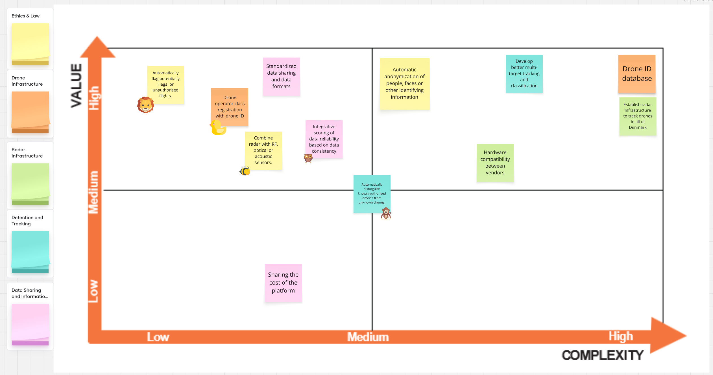
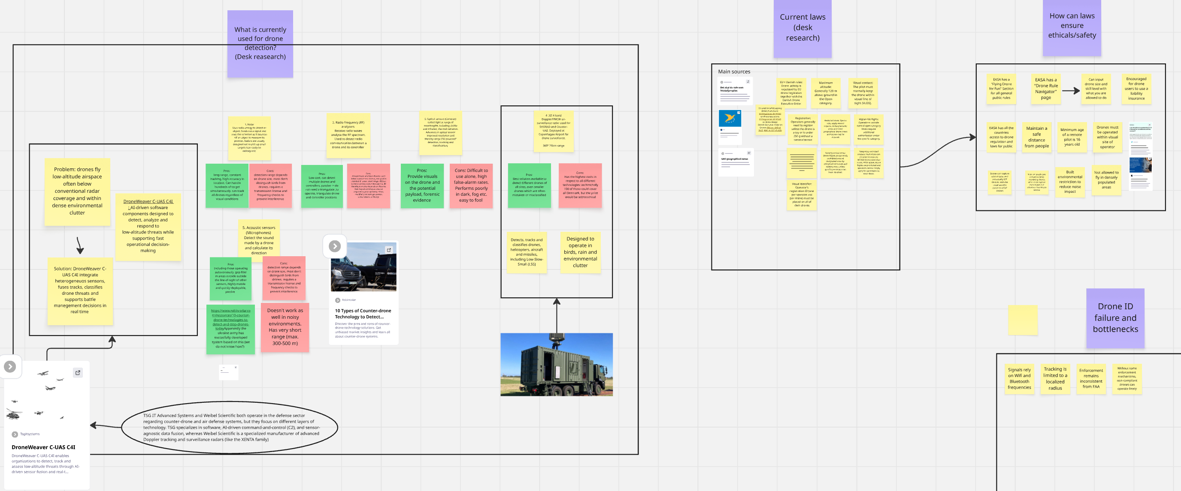
DTU Course:
Innovation in Engineering
Goal: The purpose of prioritizing your focus areas is to narrow them down to only the most important ones, before moving on to the next step. Additionally, mapping innovation opportunities helps identify where you could potentially add value for one or more of the stakeholders relevant to your innovation challenge.
What challenges did you face when prioritizing focus areas with your team, and why do you think these challenges arose?
Should opportunities always be selected based on high value and low complexity? Explain your reasoning.
What difficulties did you encounter while mapping opportunities for innovation?
Consider: Team dynamics, time management, opportunity assessment, and risk assessment.
Student name: Hákon Hlynsson
Student nr.: s225765
A)
We started by reading the case statement together as a group. Then everybody got a small focus area that they had to look into before the next meeting. When we met up the next day we presented our findings to each other, and it was pretty clear that some people had done a lot more than others. A few had gone really deep and documented everything they found, while others had spent maybe five minutes on it. That caused some frustration in the group, because the ones who had put in the work felt a bit let down. So after the presentations we agreed that we needed a minimum workload for next time, so we would not end up in the same situation again. After that we each got three stars in Miro and placed them on the focus areas we wanted to work with.
B)
Not really. The Value vs Complexity matrix helps us sort opportunities by how much value they bring compared to how hard they are to implement, so it is useful when we decide what to do first. But if you always go for the high value and low complexity option, you can end up missing a more complex idea that would actually work better in the end. It is more of a tool to help us discuss things than something that makes the decision for us. Our own Value vs Complexity matrix can be seen to the right.
C)
When we mapped the opportunities, one of the things we struggled with was that people did not agree on how easy the different ideas would be to implement. There were really two parts to it. One was how hard the thing would be to actually build, and the other was how hard it would be to get people to use it. The topic we spent the most time on was the drone ID and the database behind it. For new drones it would not be that hard, because the function could just be built in from the start, but a lot of older drones do not have the hardware for it. We also came from different backgrounds, so some of us thought it sounded easy while others thought it would be a big job. That meant it took a while before we could agree on where to place it in the matrix.
Insert Image
Our the value vs complexity matix
Insert Image
Small focus presented

Slide 3
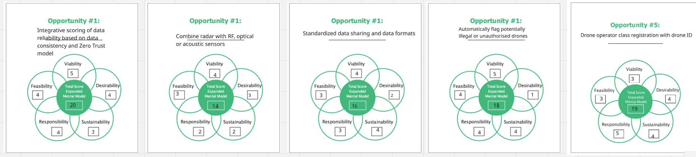
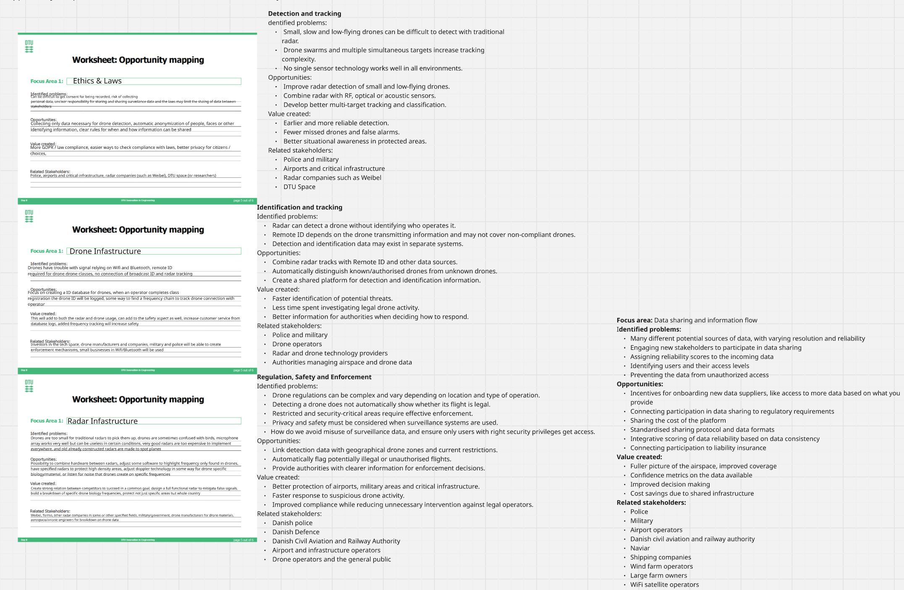
DTU Course:
Innovation in Engineering
Goal: the purpose of evaluating a list of opportunities is to assess them from different perspectives and determine which one has the highest potential value.
Reflect on your experience arranging the mindset model perspectives from easiest to most challenging
What was the most challenging aspect of writing your innovation brief? Why?
How did your team find transitioning from generating ideas to evaluating and refining concepts?
Consider: Perspective organization, communication skills, team dynamic.
Student name: Hákon Hlynsson
Student nr.: s225765
A)
After we had listed all the areas of opportunity, we picked out the five that we thought gave the most value and put them into the mindset model that you can see to the right. We then graded each of the five opportunities on the five perspectives, which were viability, desirability, sustainability, responsibility and feasibility. Each opportunity got a score from 1 to 5 on every perspective. Desirability and viability were fairly easy for us to agree on, but feasibility was the one we disagreed about the most. That was mainly because none of us really knew how much work the technical side would take, so it came down to guessing more than knowing. Sustainability and responsibility were also harder than we expected, since they are not something you can measure in the same way as cost or demand.
B)
One of the problems we had as a group while making the innovation brief was choosing which opportunity we wanted to explore, because we could not agree on which one to go for. We spent so long on that discussion that we ran out of time to fill in all the questions in the brief together. That is why we ended up splitting the questions between us and writing them separately, and then going through them all as a group afterwards so everybody agreed on the final version. We only did it that way because we did not have time to hand it in for review, so it was more of a quick fix than something we had planned.
C)
After we had brainstormed a lot of ideas about possible opportunities, we put them all into groups based on how closely they were related. From those groups we could pull out some bigger overall themes that each described a larger problem, and you can see the five big problems in the mindset model to the right. So the way we moved from generating ideas to evaluating them was by clustering everything into bigger groups first, and then running the ones that were left through the mindset model. We chose the mindset model because it forces you to look at an idea from several perspectives instead of just asking whether you like it, and that made our discussion a lot more concrete.
Insert Image
Mindset model
Insert Image
Oppotunity mapping

Slide 4
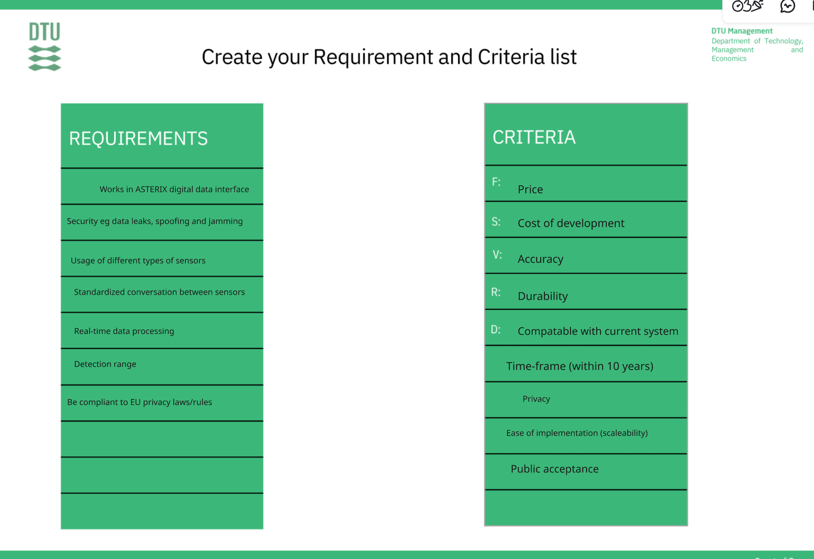
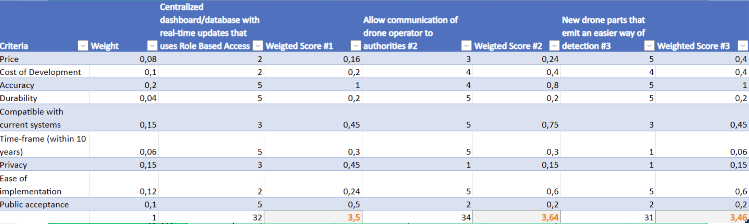
DTU Course:
Innovation in Engineering
Goal: The purpose is to reflect on your early-stage concept development process, the importance of quantitative assessment, and the comprehensive evaluation of your final concepts.
What steps did your team take to verify that each concept fits within its intended use-context, and how did you identify and address strengths, weaknesses, and needed improvements?
Why is it relevant to reassess and update your set of criteria during the concept assessment process, and how did this impact your concept evaluation?
How would you evaluate your final concept's potential in relation to the criteria in the mindset model (feasibility, viability, sustainability, and responsibility)?
Consider: Contextual analysis, critical thinking, evaluation process.
Student name: Hákon Hlynsson
Student nr.: s225765
A)
After we had found the opportunity we wanted to explore, we made a list of requirements and a list of criteria, as you can see to the right. Every proposed solution has to fit the requirements, and the criteria are what we use afterwards to judge which of them is the best. We also gave each criterion a weight, since some of them matter more than others. Before that we did an exercise where everybody wrote their own idea on a sticky note in one minute, and then we passed the notes around so everybody could add suggestions to somebody else's idea before it came back to the owner. That round was where most of the weaknesses came up, because it is easier to see what is missing in an idea you did not write yourself. We then clustered everything into five categories, pulled out three main ideas, checked them against the requirements and scored them with the weighted criteria.
B)
It is relevant to update the criteria because you write them before you have any real concepts, so they end up being quite general. When we started scoring we found out that some of them were too vague to put a number on, and that we had nothing covering privacy and public acceptance, which matters a lot for a system that tracks drones for the authorities. So we added that one and changed some of the weights, because cost turned out to be more important than we first thought. It changed the result, since the concept that looked best in the first round was not the best one afterwards. It also made the discussion easier, because a lot of our disagreement came from people reading the same criterion in different ways.
C)
Our final idea is a monitoring system that lets the authorities see when a drone is in the air and sends its location to a central hub, which can then decide if the drone is friendly or hostile and contact the operator before it gets shot down. It scores high on desirability, because it solves a problem the police already have. Viability also looks good, since planes are already tracked and drones will probably go the same way. On sustainability it could help in the long run, because a working tracking system is what makes drone delivery realistic, and that would bring emissions down. The weak points are feasibility and responsibility. The system would be expensive to build, and a lot of the drones that are already out there do not have the hardware for it. It also means more regulation and less freedom for normal operators, so the privacy side has to be handled carefully.
Insert Image
Insert Image
Evaluation of solutions

Slide 5
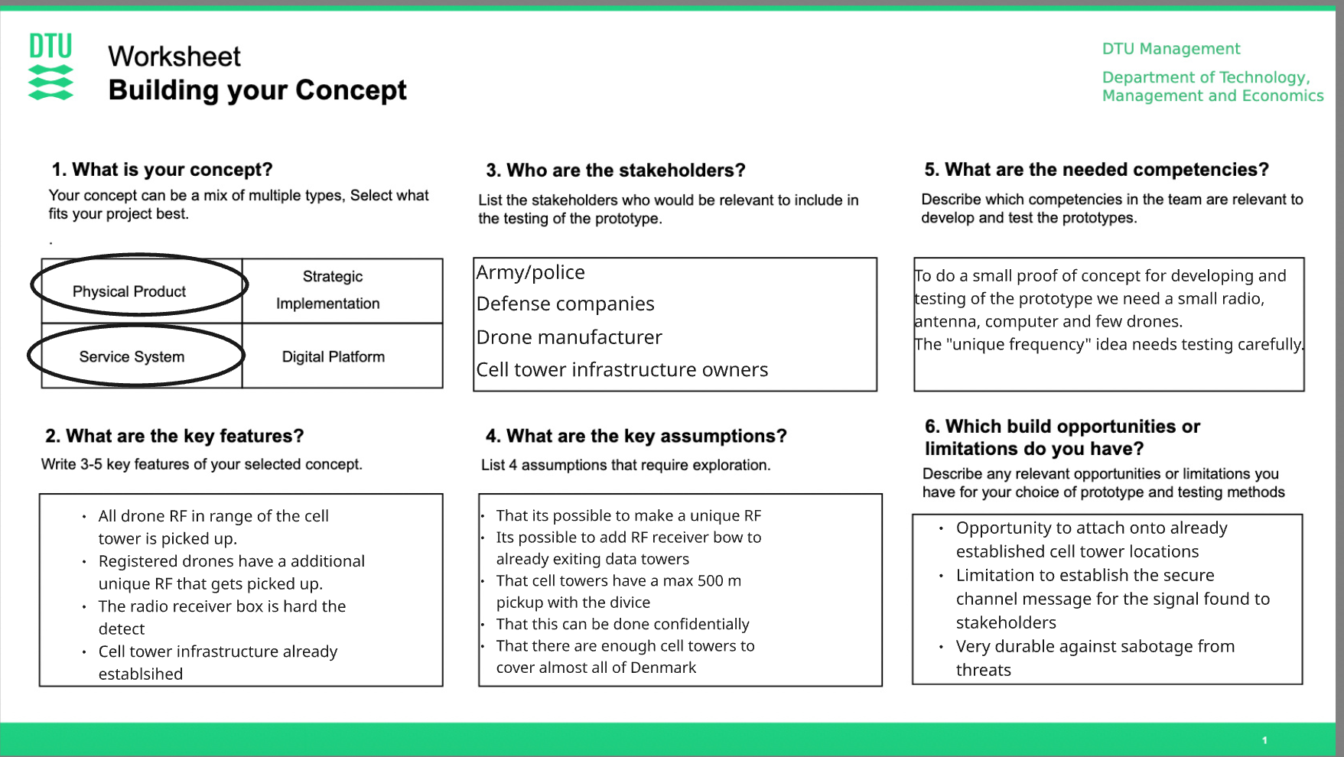
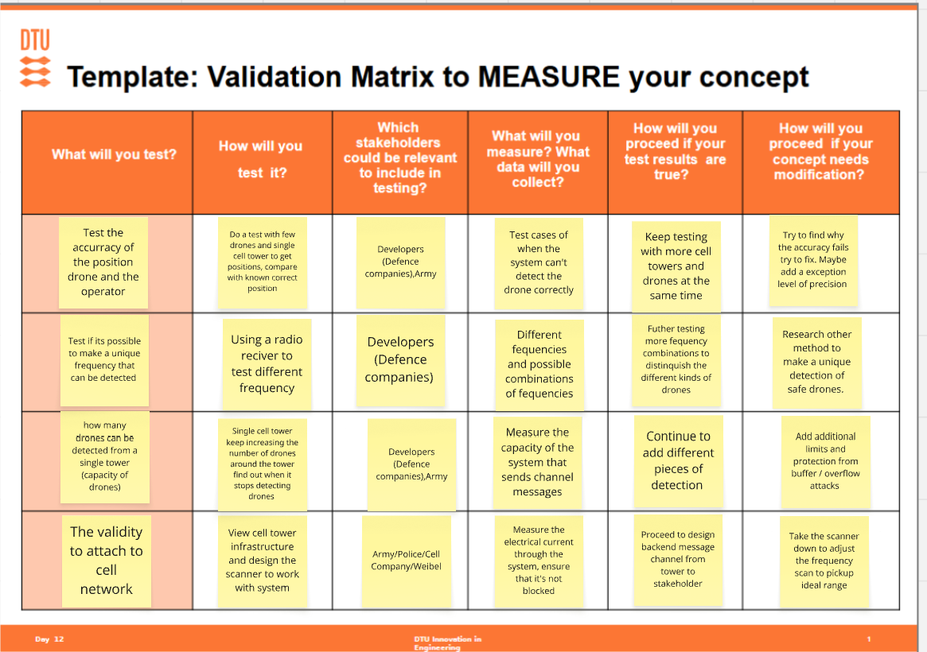
Note: We found our problem to be to wide so we have change focus to detecting drones useing ”passiv tower”(cell phone towers)
DTU Course:
Innovation in Engineering
Goal: The purpose of the first tasks is to reflect on the type of concept you have developed and to choose an appropriate prototype to test if your most crucial assumptions/hypotheses are true or false.
How do you plan to use the prototyping results to inform future iterations of your concept and how did its activities impact your priorities or approach moving forward?
What considerations are important when prototyping, and how did these influence your decisions?
What risks are associated with not investigating assumptions during prototyping and testing?
Consider: Iterative development, prototyping considerations, risk assessment
Student name: Hákon Hlynsson
Student nr.: s225765
A)
Since implementing the real system would be a very big project, we would propose a small prototype instead, where a few receivers are placed around a room and a drone is then placed inside it. The receivers should be able to detect the position of the drone, and during the test we would note both the accuracy of the receivers and the effect the surrounding area has on the signal. If the position is accurate, the next step is to try it with more receivers and more drones at the same time, since a system that only works with one drone is not worth much. If it is not, we have to find out where the error comes from and see if we can live with a lower precision. So the results decide what the next version looks like instead of us guessing. Planning the test has also changed our approach already, because we found out that our problem was too wide and we now only focus on detecting drones with passive towers.
B)
When you prototype, one of the most important things is that a person looking at it can understand what the whole system is about and see that it actually works. That was harder for us than expected, because our concept is a service system and not a product you can hold, so there is nothing obvious to show. A receiver box on a cell tower does not say much on its own. That is why we had to think about how we present it as well as how we test it, so that you can follow what happens from the drone sending a signal to the tower picking it up and the position ending up at the authorities. It also has to be simple enough that we can actually build it. Those two things are why we ended up with a room instead of a real tower, since it is cheap, we can build it ourselves and it still shows the idea.
C)
The main risk of not investigating the assumptions is that you spend a lot of time and money building a system that is based on something that is not possible. In our case the whole concept stands on the idea that a drone sends and receives communication via a frequency that a passive tower can pick up. Different towers can then triangulate the position of the operator and the drone from the difference in time between when they receive it, like it works with cell phones. If that does not hold, we would only find out at the end where it is expensive to change anything. There is also a risk of losing the stakeholders, because the authorities and the tower owners will not put resources into something that has only been research tested. Testing early means it could be discovered that it would not work in real life, while it is still cheap to be wrong.
Insert Image
Insert Image

